Slide 1


Making a Case for a Green500 List
S. Sharma†, C. Hsu†, and W. Feng‡
Presenter: Pavan Balaji
The Ohio State University
Notes:
Ad-lib and improvise as needed. I’ve only noted the basics. You do NOT need to say everything word-for-word with respect to what I type on the Notes pages. I am only typing it all out to give you a general idea of what should be said. You do NOT need to say everything exactly word-for-word.
Opening:
My name is Pavan Balaji. I am a graduating PhD student from The Ohio State University, who worked as a research intern with Prof. Feng when he was at Los Alamos National Laboratory.

Slide 2
Outline
Introduction
What Is Performance?
Motivation: The Need for a Green500 List
Challenges
What Metric To Choose?
Comparison of Available Metrics
TOP500 as Green500
Conclusion

Slide 3
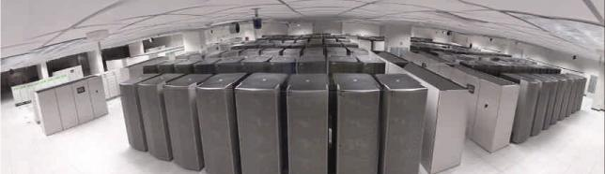
What Is Performance?
Performance = Speed, as measured in FLOPS
Notes:
We have spent DECADES focusing on performance (i.e., speed) as THE performance metric, e.g., TOP500.
Top 500 Supercomputer List
Gordon Bell Awards at SC
ELAPSED TIME for slides 1-3: 1.5 minutes.

Slide 4
What Is Performance? TOP500 Supercomputer List
Benchmark
LINPACK: Solves a (random) dense system of linear equations in double-precision (64 bits) arithmetic.
Introduced by Prof. Jack Dongarra, U. Tennessee
Evaluation Metric
Performance (i.e., Speed)
Floating-Operations Per Second (FLOPS)
Web Site
http://www.top500.org
Next-Generation Benchmark: HPC Challenge
http://icl.cs.utk.edu/hpcc/
Performance, as defined by speed, is an important metric, but…
Notes:
ELASPED TIME for slides 1-4: 2 minutes

Slide 5
Reliability & Availability of HPC
Systems | CPUs | Reliability & Availability
ASCI Q | 8,192 | MTBI: 6.5 hrs. 114 unplanned outages/month. HW outage sources: storage, CPU, memory.
ASCI White | 8,192 | MTBF: 5 hrs. (2001) and 40 hrs. (2003). HW outage sources: storage, CPU, 3rd-party HW.
NERSC Seaborg | 6,656 | MTBI: 14 days. MTTR: 3.3 hrs. SW is the main outage source. Availability: 98.74%.
PSC Lemieux | 3,016 | MTBI: 9.7 hrs. Availability: 98.33%.
Google | ~15,000 | 20 reboots/day; 2-3% machines replaced/year. HW outage sources: storage, memory. Availability: ~100%.
MTBI: mean time between interrupts; MTBF: mean time between failures; MTTR: mean time to restore
Notes:
Focusing only on performance, as defined by speed, has resulted in unreliable and finicky systems.
These unreliable and finicky systems lead to an exorbitant total cost of ownership, e.g., new buildings, new machine rooms, excessive use of electrical power, loss productivity due to downtime, and so on. See next slide.
Pavan: Below is just FYI. You do not need to explicitly define these, unless asked.
MTBI: wall clock hours / # downtime periods
MTBF: mean time between failures
MTTR: downtime hours / # downtime periods
ONCE MTBI AND MTBF ARE IMPROVED ENOUGH, SW BECOMES THE MAIN SOURCE OF OUTAGE, i.e., there is a cross-over point.
ELAPSED TIME for slides 1-5: 3 minutes

Slide 6
Costs Associated with HPC
Infrastructure
Sizable costs associated with system administration and maintenance. (People resources are $$$.)
Massive construction and operational costs associated with powering and cooling.
Google
$2M to buy 30 acres of land by The Dalles Dam (Columbia River)
Inexpensive power to satisfy their high electrical demand.
Water can be used to cool its massive server-filled facility directly rather than relying on more expensive A/C.
Lawrence Livermore National Laboratory
Building for Terascale Simulation Facility: $55M
Electrical Costs: $14M/year to power and cool.
Productivity
Downtime means no compute time, i.e., lost productivity.
Notes:
FWIW: Virginia Tech
Since System X moved into production in January 2006,
Zero downtime
99.9% system utilization
ELAPSED TIME for slides 1-6: 4.5 minutes

Slide 7
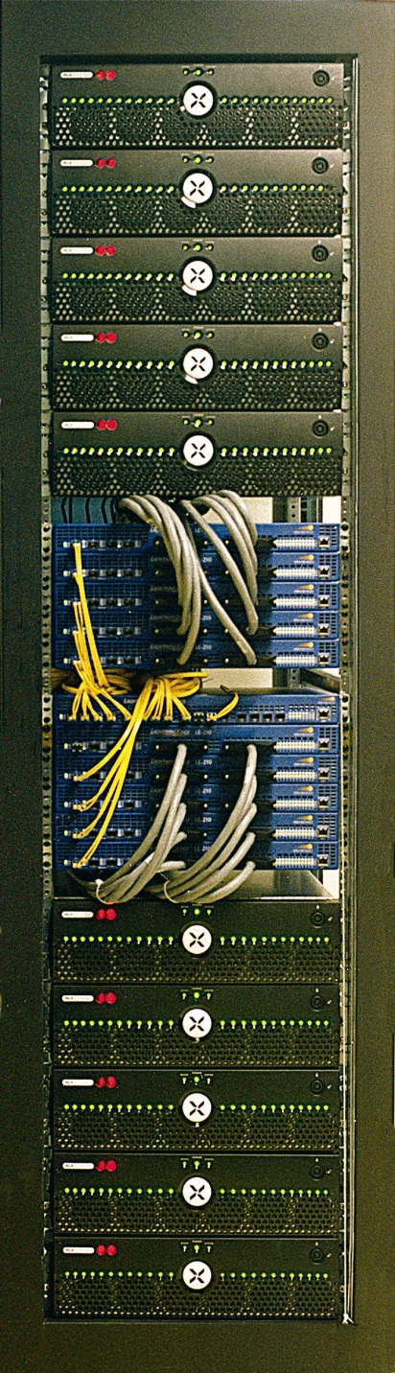
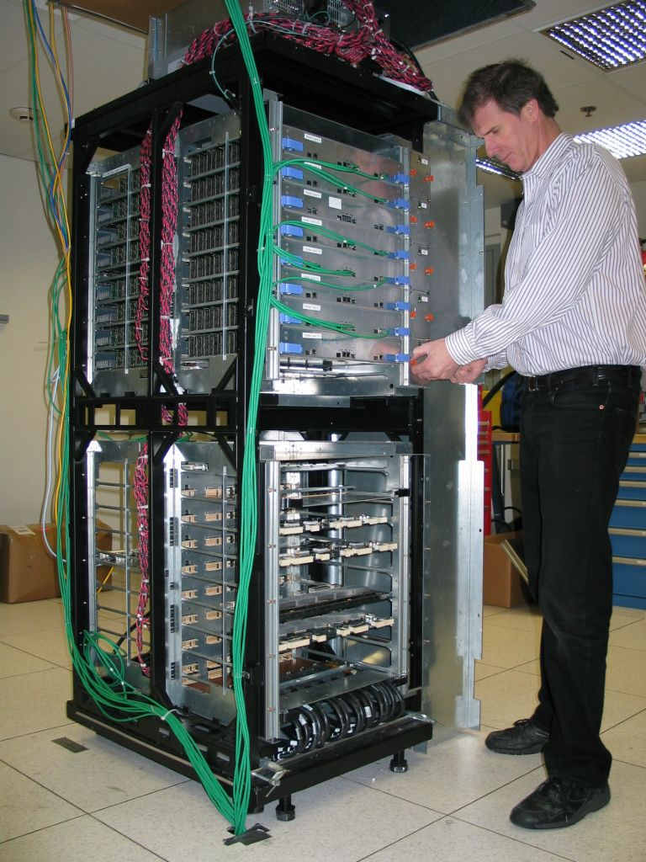
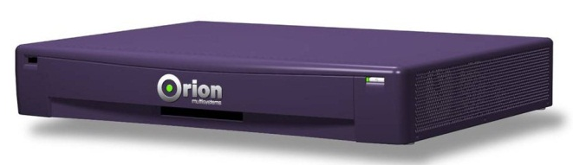
Recent Trends in HPC
Low(er)-Power Multi-Core Chipsets
AMD: Athlon64 X2 (2) and Opteron (2)
ARM: MPCore (4)
IBM: PowerPC 970 (2)
Intel: Smithfield (2) and Montecito (2)
PA Semi: PWRficient (2)
Low-Power Supercomputing
Green Destiny (2002)
Orion Multisystems (2004)
BlueGene/L (2004)
MegaProto (2005)
180/360 TF/s
16 TB DDR
October 2003
BG/L half rack prototype
500 Mhz
512 nodes/1024 proc.
2 TFlop/s peak
1.4 Tflop/s sustained
Notes:
Recent low-power trends in HPC that seek to address the issues of reliability, availability, and total cost of ownership.
AMD: Each chipset has up to 2 cores.
ARM: MPCore has up to 4 cores.
Etc.

Slide 8
Perspective
FLOPS Metric of the TOP500
Performance = Speed (as measured in FLOPS with Linpack)
May not be “fair” metric in light of recent low-power trends to help address reliability, availability, and total cost of ownership.
The Need for a Different Performance Metric
Performance = f ( speed, “time to answer”, power consumption, “up time”, total cost of ownership, usability, …)
Easier said than done …
Many of the above dependent variables are difficult, if not impossible, to quantify, e.g., “time to answer”, TCO, usability, etc.
The Need for a Green500 List
Performance = f ( speed, power consumption) as speed and power consumption can be quantified
Notes:
Because of these recent low-power trends in HPC -- trends that oftentimes sacrifice speed for other desirable attributes such as reliability, availability, and total cost of ownership -- we need a different set of metrics to define what “performance” means …
Performance should be a function “f” of a multitude of metrics such as peak speed, time-to-answer, power consumption, total cost of ownership, and so on … but many of these dependent variables are difficult to quantify.
We argue that AT A MINIMUM, there is a need for a Green500 List, particularly given that power consumption is indirectly related to many metrics of interest, i.e., reliability, availability, and total cost of ownership.

Slide 9
Outline
Introduction
What Is Performance?
Motivation: The Need for a Green500 List
Challenges
What Metric To Choose?
Comparison of Available Metrics
TOP500 as Green500
Conclusion

Slide 10
Challenges for a Green500 List
What Metric To Choose?
ED ^{n} : Energy-Delay Products, where n is a non-negative int.
(borrowed from the circuit-design domain)
Variants of ED ^{n}
Speed / Power Consumed
FLOPS / Watt, MIPS / Watt, and so on
What To Measure? Obviously, energy or power … but
Energy (Power) consumed by the computing system?
Energy (Power) consumed by the processor?
Temperature at specific points on the processor die?
How To Measure Chosen Metric?
Power meter? But attached to what? At what time granularity should the measurement be made?
Notes:
What to Measure?
We know that we have to measure energy (or power), but energy (or power) of what? Of the entire computing system? Of just the processor? What about measuring the temperature instead (in light of Arrenhius’ equation, see the very last slide of this presentation, i.e., “Improving Reliability & Availability)
How To Measure?
How exactly do we measure the energy (power) of a computing system? Or how about a processor? Do we put probes on the power pins to the CPU ASIC?

Slide 11
ED ^{n} : Energy-Delay Products
Original Application
Circuit Design
Problem
For n ≥ 1, the metric is biased towards systems with a larger number of processors as the “delay component” (i.e., aggregate speed) dominates.
As n increases, the bias towards aggregate speed, and hence, HPC systems with larger numbers of processors, increases dramatically.

Slide 12
Variants of ED ^{n} : V∂ =E^{(1−∂)} D^{2(1+∂)}
Negative values of ∂ (particularly more negative values) marginally offset the bias of the ED ^{n} towards speed.
In our benchmarking, they produced identical rankings to the ED ^{n} metric.
Positive values of ∂ place greater emphasis on performance.
As ∂ increases towards one, the metric approaches the limit E ⁰D ⁴ and behaves more like the standard FLOPS metric, which is used for TOP500 List.
Metric of Choice: FLOPS / Watt (again)

Slide 13
Outline
Introduction
What Is Performance?
Motivation: The Need for a Green500 List
Challenges
What Metric To Choose?
Comparison of Available Metrics
TOP500 as Green500
Conclusion

Slide 14
Efficiency of Four-CPU Clusters
Name | CPU | LINPACK (Gflops) | Avg Pwr (Watts) | Time (s) | ED (*10⁶) | ED2 (*10⁹) | Flops/W | V_{∂=−0.5}
C1 | 3.6G P4 | 19.55 | 713.2 | 315.8 | 71.1 | 22.5 | 27.4 | 33.9
C2 | 2.0G Opt | 12.37 | 415.9 | 499.4 | 103.7 | 51.8 | 29.7 | 47.2
C3 | 2.4G Ath64 | 14.31 | 668.5 | 431.6 | 124.5 | 53.7 | 21.4 | 66.9
C4 | 2.2G Ath64 | 13.40 | 608.5 | 460.9 | 129.3 | 59.6 | 22.0 | 68.5
C5 | 2.0G Ath64 | 12.35 | 560.5 | 499.8 | 140.0 | 70.0 | 22.0 | 74.1
C6 | 2.0G Opt | 12.84 | 615.3 | 481.0 | 142.4 | 64.5 | 20.9 | 77.4
C7 | 1.8G Ath64 | 11.23 | 520.9 | 549.9 | 157.5 | 86.6 | 21.6 | 84.3

Slide 15
Green500 Ranking of Four-CPU Clusters
Green500 Ranking |  |  |  |  |  |  | TOP 500 | Power500
Rank | ED | ED² | ED³ | V_{∂=−0.5} | V_{∂=0.5} | FLOPS/Watt | FLOPS | Watts
1 | C1 | C1 | C1 | C1 | C1 | C2 | C1 | C2
2 | C2 | C2 | C2 | C2 | C3 | C1 | C3 | C7
3 | C3 | C3 | C3 | C3 | C4 | C5 | C4 | C5
4 | C4 | C4 | C4 | C4 | C2 | C4 | C6 | C4
5 | C5 | C5 | C5 | C5 | C5 | C7 | C2 | C6
6 | C6 | C6 | C6 | C6 | C6 | C3 | C5 | C3
7 | C7 | C7 | C7 | C7 | C7 | C6 | C7 | C1

Slide 16
Outline
Introduction
What Is Performance?
Motivation: The Need for a Green500 List
Challenges
What Metric To Choose?
Comparison of Available Metrics
TOP500 as Green500
Conclusion

Slide 17
TOP500 Power Usage
Name | Linpack | Peak Power | MFLOPS/W | TOP500 Rank
BlueGene/L | 367,000 | 2,500 | 146.80 | 1
ASC Purple | 77,824 | 7,600 | 10.24 | 3
Columbia | 60,960 | 3,400 | 17.93 | 4
Earth Simulator | 40,960 | 11,900 | 3.44 | 7
MareNostrum | 42,144 | 1,071 | 39.35 | 8
Jaguar-Cray XT3 | 24,960 | 1,331 | 18.75 | 10
ASC Q | 20,480 | 10,200 | 2.01 | 18
ASC White | 12,288 | 2,040 | 6.02 | 47

Slide 18
TOP500 as Green500
Relative Rank | TOP500 | Green500
1 | BlueGene/L (IBM) | BlueGene/L (IBM)
2 | ASC Purple (IBM) | MareNostrum (IBM)
3 | Columbia (SGI) | Jaguar-Cray XT3 (Cray)
4 | Earth Simulator (NEC) | Columbia (SGI)
5 | MareNostrum (IBM) | ASC Purple (IBM)
6 | Jaguar-Cray XT3 (Cray) | ASC White (IBM)
7 | ASC Q (HP) | Earth Simulator (NEC)
8 | ASC White (IBM) | ASC Q (HP)

Slide 19
Conclusion
Metrics for a Green500 Supercomputer List
Still no definitive metric to use
By process of elimination, we converged on FLOPS/watt, which is relatively easy to derive from the TOP500 Supercomputer List.
Insight with respect to current metrics
TOP500 as Green500
From the data presented, IBM and Cray make the most energy-efficient HPC systems today.

Slide 20

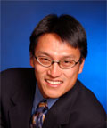
For More Information
Visit “Supercomputing in Small Spaces” at http://sss.lanl.gov
Soon to be re-located to Virginia Tech
Contact Wu-chun Feng (a.k.a. “Wu”)
E-mail: feng@cs.vt.edu
Phone: (540) 231-1192
Mailing Address
2200 Kraft Drive
Department of Computer Science
Virginia Tech
Blacksburg, VA 24060

Slide 21
EXTRA SLIDES

Slide 22
Moore’s Law for Power
1000
Chip Maximum
Power in watts/cm²
Not too long to reach
Nuclear Reactor
Itanium – 130 watts
100
Pentium 4 – 75 watts
Surpassed
Heating Plate
Pentium III – 35 watts
Pentium II – 35 watts
Pentium Pro – 30 watts
10
Pentium – 14 watts
I486 – 2 watts
I386 – 1 watt
1
1.5μ
1μ
0.7μ
0.5μ
0.35μ
0.25μ
0.18μ
0.13μ
0.1μ
0.07μ
1985
1995
2001
Year
Source: Fred Pollack, Intel. New Microprocessor Challenges in the Coming Generations of CMOS Technologies, MICRO32 and Transmeta
Notes:
What is the cost here? Increased performance at the cost of power dissipation, and hence, reliability.
Problem: Will Transmeta survive in these economic times and against Intel/AMD? NO.

Slide 23
Improving Reliability & Availability (Reducing Costs Associated with HPC)
Observation
High power density α high temperature α low reliability
Arrhenius’ Equation*
(circa 1890s in chemistry → circa 1980s in computer & defense industries)
As temperature increases by 10° C …
The failure rate of a system doubles.
Twenty years of unpublished empirical data .
* The time to failure is a function of e^{-Ea/kT} where Ea = activation energy of the failure mechanism being accelerated, k = Boltzmann's constant, and T = absolute temperature
Notes:
Approaches:
Address power. Sarita Adve (UIUC), T.N. Vijaykumar (Purdue), Kaushik Roy (Purdue), Dean Tullsen (UCSD). Virtually all the work (except IBM Blue Gene) is simulation-based.
Screw power and ignore efficiency. Assume unreliability … more easily done with Google application though.
Google approach … More easily done because problem is embarrassingly parallel. Sub-tasks are largely decoupled from each other. Availability: 100% (until a couple of weeks ago when Akamai was hacked).
(3) Address power.

